Slide 1
Gen-AI
Gen AI Application Developer FY'26 Batch-1 (Morning Slot)-20250708_060402-Meeting Recording.mp4
Dr. Rakhee Chhibber

Slide 2
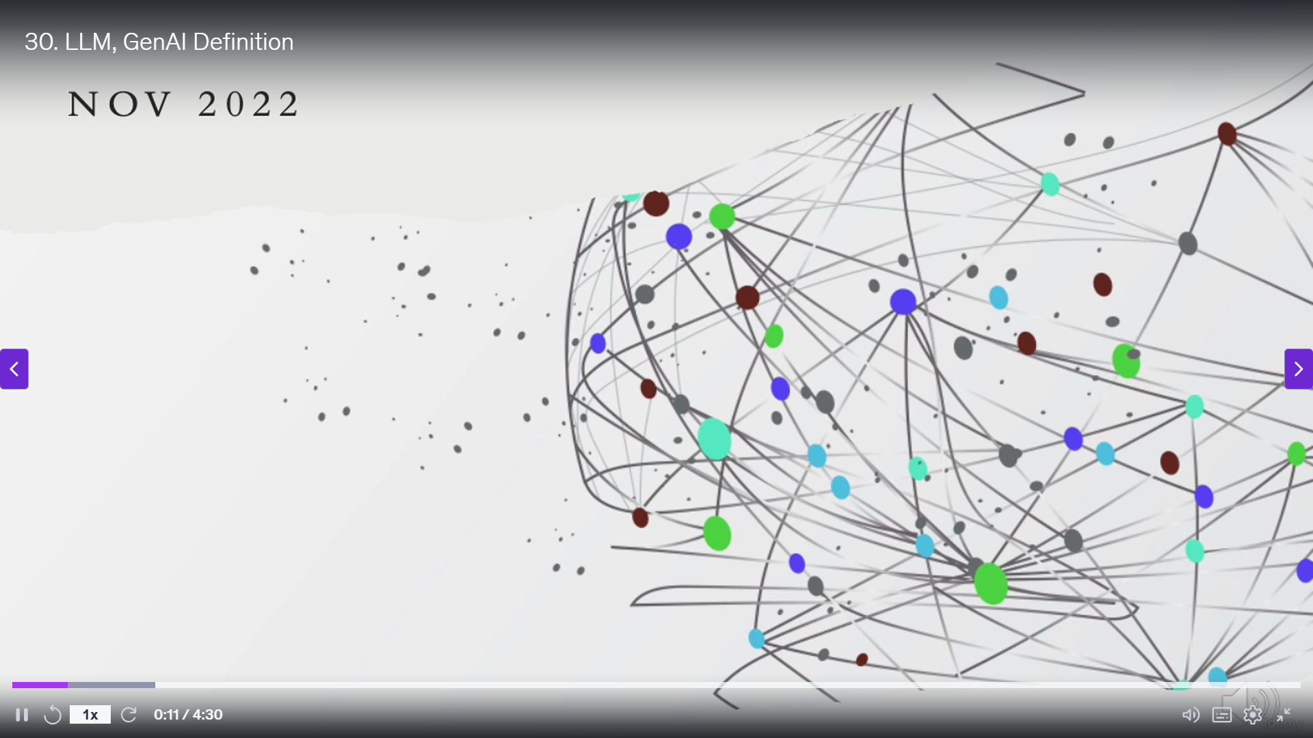
Gen-AI
Dr. Rakhee Chhibber

Slide 3
Introduction
Generative AI is a branch of artificial intelligence that focuses on creating new content such as text, images, code, music and video using models like transformers, GANs and diffusion models.
It is used in tools like
ChatGPT, Claude, Gemini and DALL·E
and is widely applied in
automation, chatbots and personalization.

Slide 4
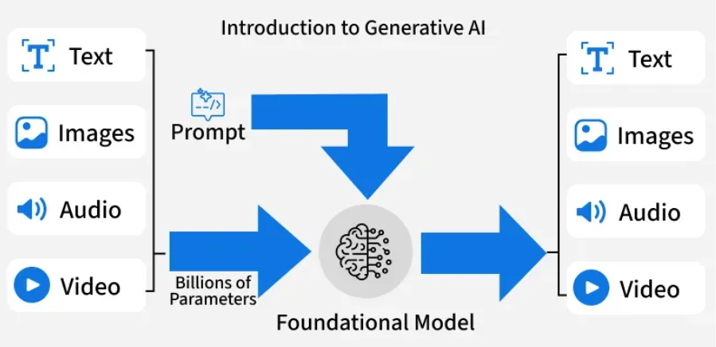

Slide 5
GPT Architecture

Slide 6
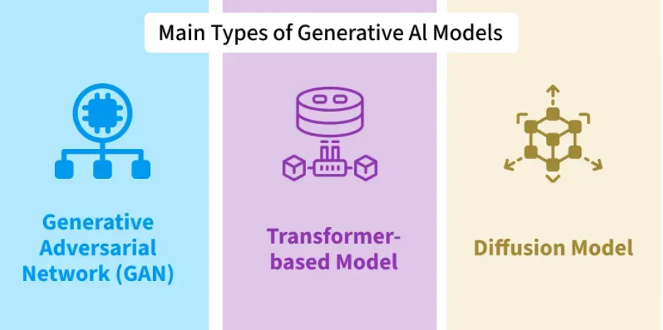

Slide 7
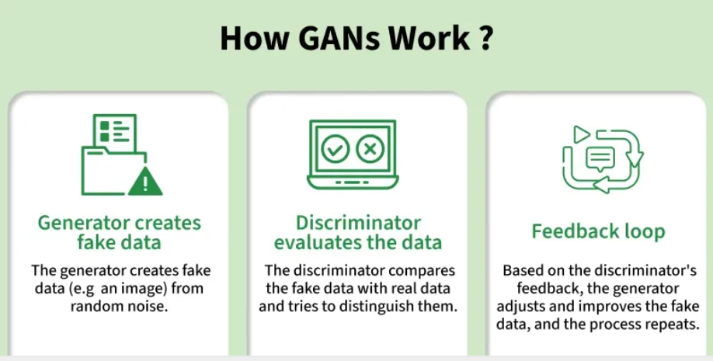
Generative Adversarial Networks (GANs)
GANs is among the first deep learning architectures for generative tasks.
GANs uses two networks against each other a generator that tries to produce realistic outputs and a discriminator that tries to detect fakes.
This adversarial setup leads to sharp, lifelike images.

Slide 8
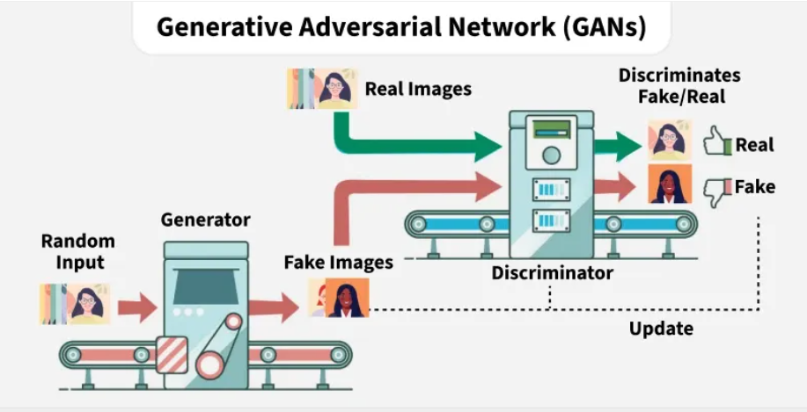

Slide 9
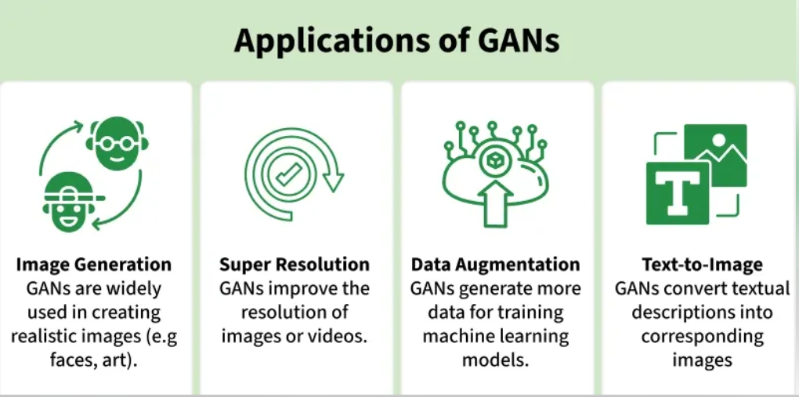

Slide 10
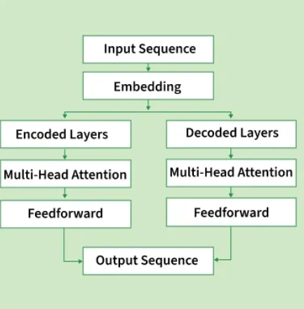
Transformers or Autoregressive Models
Autoregressive Transformers Models generate sequences by predicting the next token based on all previous ones.
The architecture relies on the transformer’s self attention mechanism to capture context.
Popular examples include GPT models which can produce coherent, context aware paragraphs, solve coding tasks or answer complex queries.

Slide 11
Diffusion
Diffusion models generate data such as images or audio by starting with pure random noise and gradually refining it into a coherent output through a series of denoising steps.
This iterative approach can produce highly detailed and realistic results specially in image synthesis where models like Stable Diffusion and DALL·E 3 have set benchmarks.
Diffusion models are also versatile they can be adapted for inpainting, style transfer and conditional generation from text prompts.

Slide 12
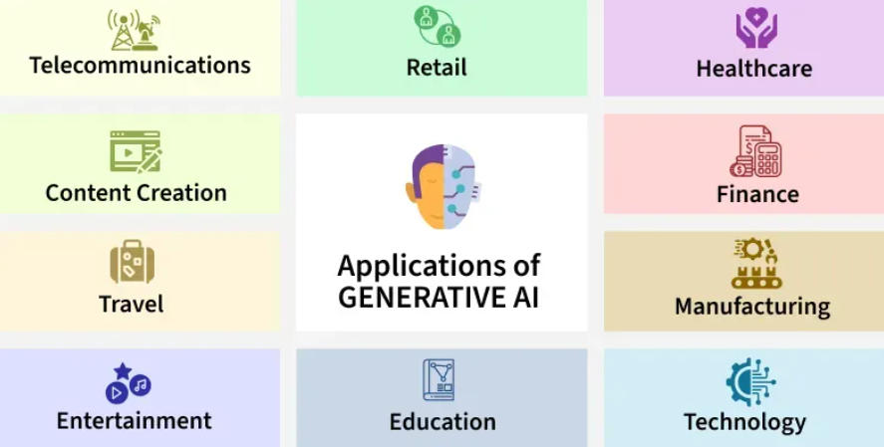

Slide 13
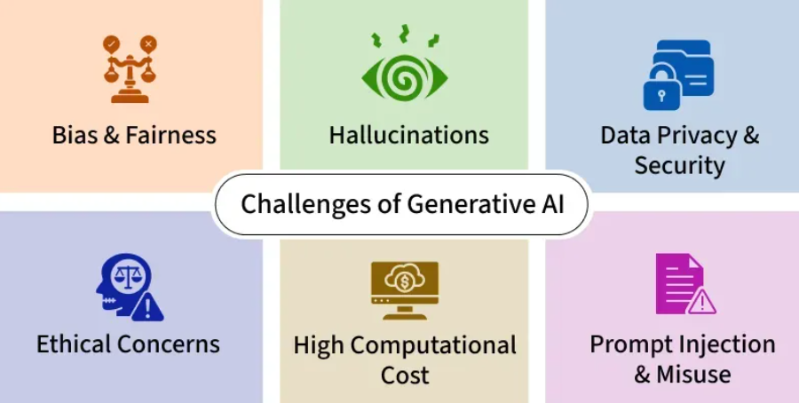

Slide 14
Tools & Libraries for Generative AI
Python
PyTorch
TensorFlow
Hugging Face Transformers
LangChain
LangGraph
Langflow
LlamaIndex
Integration of Langchain with Llama-Index

Slide 15
LLMs

Slide 16
Introduction
LLMs are neural networks trained on vast amounts of text data. They learn patterns, relationships, and language structure.
Key characteristics:
  Large: Billions of parameters (weights)
  Language: Understand and generate human language
  Models: Mathematical representations of language patterns
Input Text → Neural Network → Probability Distribution → Generated Text

Slide 17
Popular LLMs
OpenAI Models:
  GPT-3.5/GPT-4: General-purpose, powerful
  GPT-4 Turbo: Faster, more efficient
  Embedding models: Convert text to vectors
Other Models:
  Claude (Anthropic): Strong reasoning
  Llama (Meta): Open-source alternative
  Gemini (Google): Multimodal capabilities

Slide 18
Understanding Tokens
LLMs process text in tokens, not words:
  1 token ≈ 4 characters (roughly)
  "Hello world" = 2 tokens
  "RAG system" = 3 tokens
Why it matters:
  API pricing is often per token
  Models have token limits (context windows)
  You need to manage token usage efficiently

Slide 19
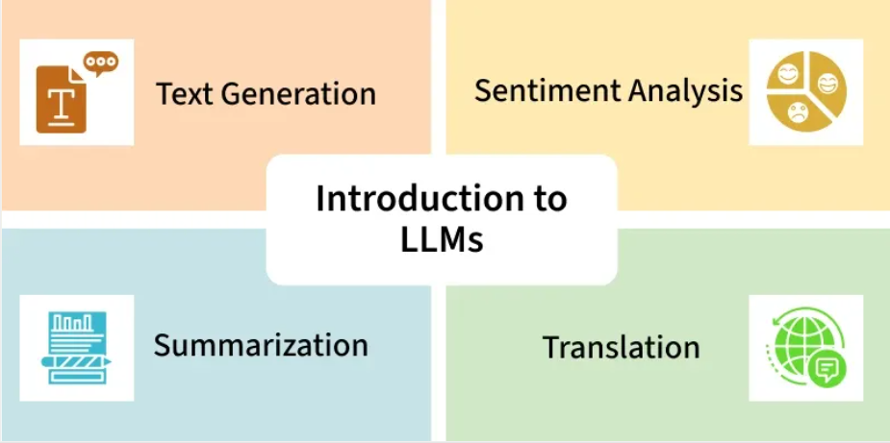
Large Language Models (LLMs)
are machine learning models trained on vast amount of textual data to generate and understand human-like language. These models can perform a wide range of natural language processing tasks from text generation to sentiment analysis and summarization.

Slide 20
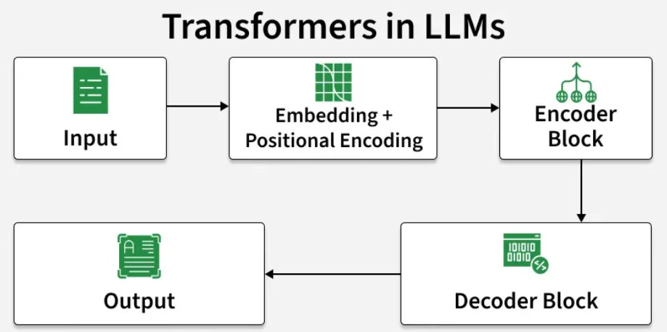

Slide 21
Popular Large Language Models
GPT (Generative Pre-trained Transformer)
BERT (Bidirectional Encoder Representations from Transformers)
T5 (Text-to-Text Transfer Transformer)
LLaMA
Claude
LCM (Large Concept Models)
Falcon

Slide 22
Applications of LLMs
1. Chatbots/ Conversational AI
Building Chatbot using Gemini
Building Chatbot using OpenAI
Building Chatbot using LLama3
2. Sentiment Analysis
Sentiment analysis using BERT
3. Text Generation
Text generation using FNet
Text2text generation using Hugging Face Model
4. Language Translation
Machine Translation using Transformer

Slide 23
Training and Fine-Tuning LLMs

Slide 24
Training Language Modela
Autoregressive Models
Masked Language Models
Causal Language Models

Slide 25
Language Modeling Techniques
Autoregressive Models
Masked Language Models
Causal Language Models
RNN
LSTM/GRU
Transformer Based
GPT
BERT
BERT
RoBERTa
ALBERT
DistilBERT
GPT
GPT-Neo
PALM
LLaMA

Slide 26
Autoregressive Models
Recurrent Neural Networks (RNNs)
  process input sequences sequentially, maintaining a hidden state that captures information from previous tokens.
Long Short-Term Memory and Gated Recurrent Units
  advanced variants of RNNs designed to address the vanishing gradient problem.
Transformer-Based Models:
  GPT (Generative Pre-trained Transformer) :
    Developed by OpenAI,
    unidirectional transformer that generates text autoregressively.
    highly successful in tasks like text completion, story generation, and question answering.
  BERT (Bidirectional Encoder Representations from Transformers) :
    bidirectional and not strictly autoregressive
    Variants like BART and T5 combine autoregressive decoding with bidirectional encoding.

Slide 27
Masked Language Models
BERT (Bidirectional Encoder Representations from Transformers) :
  Developed by Google BERT
  introduced the concept of bidirectional training
  used for tasks like question answering, text summarization and sentiment analysis.
RoBERTa (Robustly Optimized BERT Pretraining Approach) :
  An improved version of BERT RoBERTa
  uses more training data and optimizes the masking strategy to achieve better performance.
ALBERT (A Lite BERT) :
  A lighter and more efficient version of BERT,
  reduces the model size while maintaining high performance.
DistilBERT :
  A smaller, faster version of BERT that retains most of its capabilities but requires fewer computational resources.

Slide 28
Causal Language Models
GPT (Generative Pre-trained Transformer) :
  developed by OpenAI GPT
  generate human-like text, answer questions, and even write code.
  Versions like GPT-3 and GPT-4
  remarkable capabilities in creative and technical writing.
GPT-Neo and GPT-J :
  similar functionality but with reduced computational requirements.
PaLM (Pathways Language Model) :
  Developed by Google
  a large-scale causal language model capable of performing a wide range of tasks, including reasoning and multi-language translation.
LLaMA (Large Language Model Meta AI) :
  Created by Meta
  causal language model designed for research purposes, with impressive text generation capabilities.

Slide 29
Fine-Tuning LLMs

Slide 30
Reinforcement Learning from Human Feedback (RLHF)
Fine-Tune an LLM from Hugging Face
Parameter-Efficient Fine-Tuning (PEFT)
Fine Tuning LLMs using PEFT
LoRA (Low-Rank Adaptation)
QLoRA (Quantized Low-Rank Adaptation)
Fine Tuning LLMs using QLoRA
Prompt Tuning

Slide 31
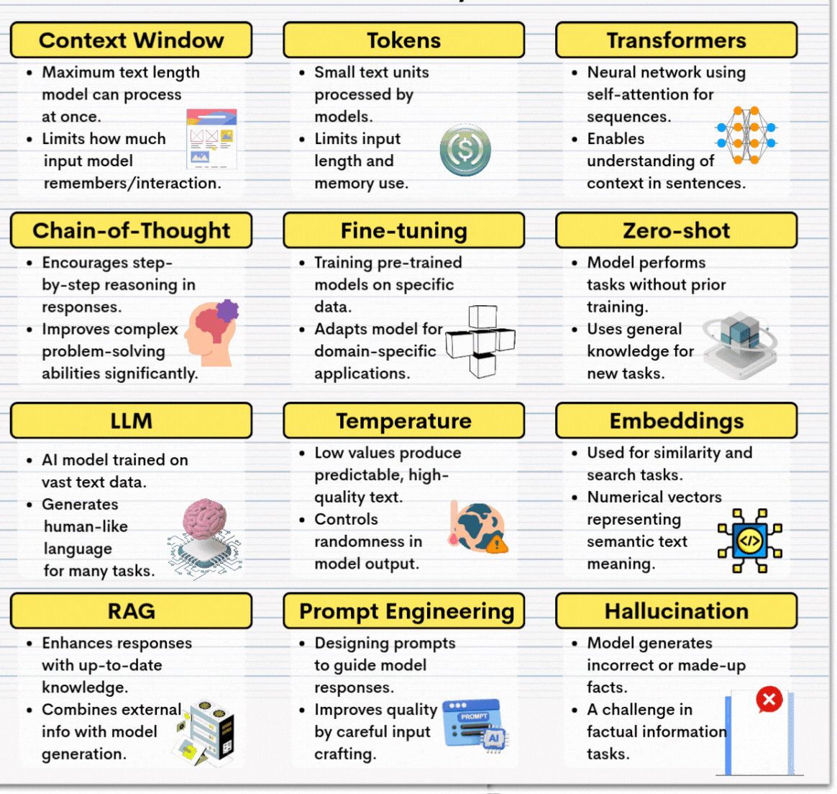
Gen AI Terms you should Always know

Slide 32
List of APIs – get the list of model using different APIs
Openai
https://github.com/rcstaracademy/GenAI/blob/main/module%206/Open_API_MODELS.ipynb
Llama – display using hugging face - https://github.com/rcstaracademy/GenAI/blob/main/module%206/Hugging_Face_MODEL_List.ipynb
Claude anthropic – Fixed models
https://github.com/rcstaracademy/GenAI/blob/main/module%206/Antropic_Models.ipynb
Mistral ai
https://github.com/rcstaracademy/GenAI/blob/main/module%206/Hugging_Face_MODEL_List.ipynb
Hugging face - display using hugging face
https://github.com/rcstaracademy/GenAI/blob/main/module%206/Hugging_Face_MODEL_List.ipynb
Gemini – don’t provide a list of models

Slide 33
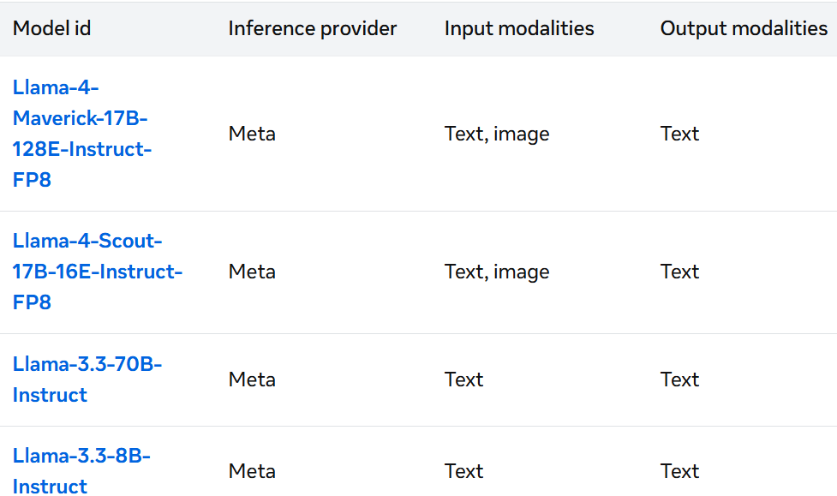
Llama – models

Slide 34
Gemini (Google Gemini API)
Google Gemini does not provide a direct “list models” endpoint like OpenAI.
Instead, you select the model name manually from Google’s documentation.
Common Gemini model names
gemini-1.5-pro
gemini-1.5-mini
gemini-1.5-small
gemini-1.0-pro
gemini-1.0-mini

Slide 35
Thank You

